Slide 1
TEST YOUR
INTELLIGENCE

Slide 2
The following sentences sound correct, but there is something wrong with each one. What is wrong?

Slide 3
#1. This book fills a badly
needed gap
in your education.

Slide 4
#1. This book fills a badly needed gap
in your education.
No one needs a ‘gap’ in his/her education.

Slide 5
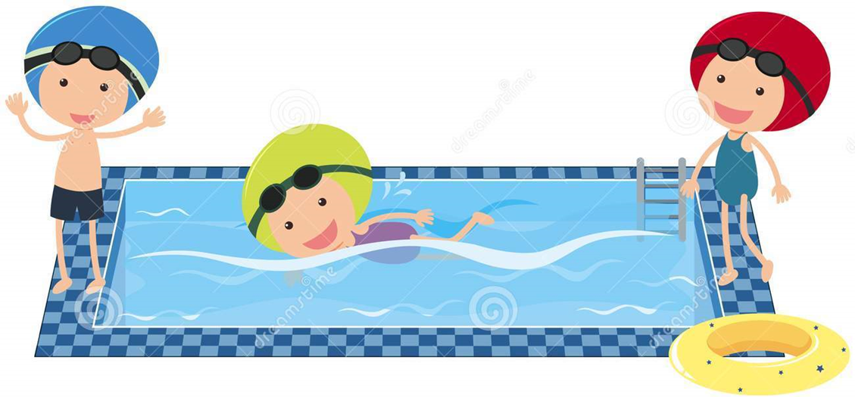
#2. Don’t go near the water until you have learned how to swim.

Slide 6
#2. Don’t go near the water until you have learned how to swim.
You can’t learn to swim unless you go in the water.

Slide 7
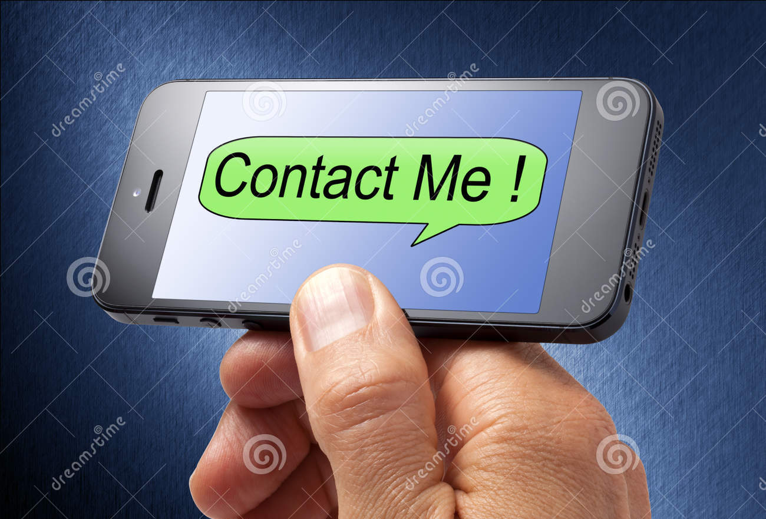
#3. If you get this message, call me right away; otherwise don’t call.

Slide 8
#3. If you get this message, call me right away; otherwise don’t call.
If you didn’t get the message you won’t know that you should or should not call.

Slide 9
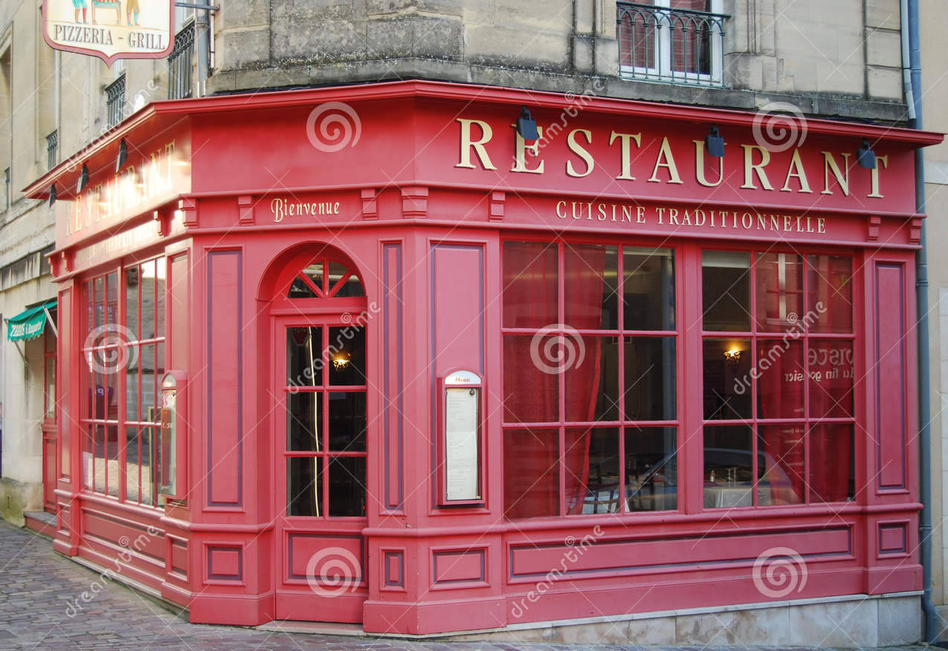
#4. No one goes to that restaurant any more because it’s always so crowded.

Slide 10
#4. No one goes to that restaurant any more because it’s always so crowded.
If the restaurant is crowded, that means many people go there. If nobody went to that place if wouldn’t be crowded

Slide 11
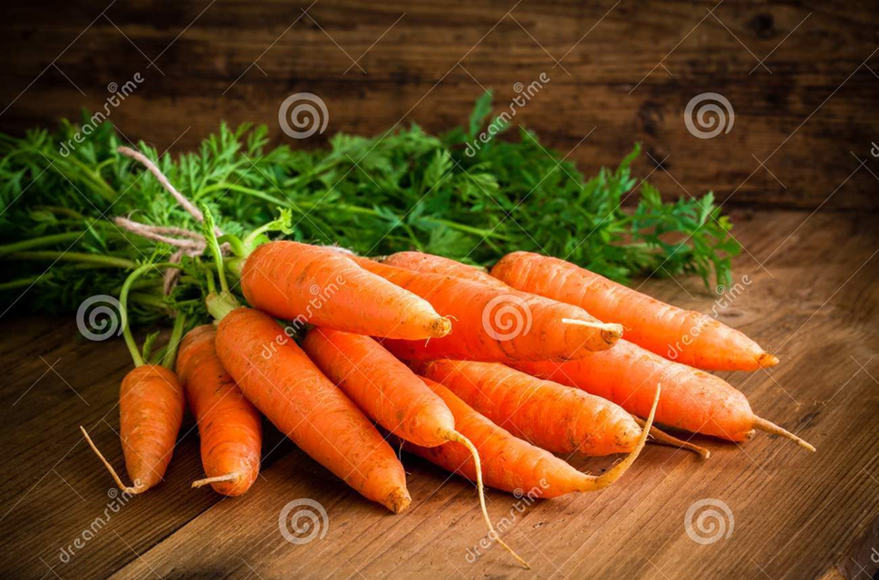
#5. I’m glad I don’t like carrots, because if I liked them I’d eat them, and they taste
awful.

Slide 12
#5. I’m glad I don’t like carrots, because if I liked them I’d eat them, and they taste awful.
If you liked carrots you would not think they taste awful.

Slide 13
#6. If you can read this sign, please ask for help.

Slide 14
#6. If you can read this sign, please ask for help.
If you can’t read the sign, you can’t know that you should ask for help.

Slide 15
THE END

